Slide 1

Unit 4 Learning
Ms. Kritika Purohit
Assistant Professor
Department of Computer Science & Engineering

Slide 2
Points to be covered-
Introduction
Types of Learnings
Decision Tree
Search Vector Machine
Market Basket Analysis
Artificial Neural Network
Neural Network Tools

Slide 3
Introduction-
Machines can not be called Intelligent until they are able to learn to do things and to adapt new situations, rather than simply doing as they are told to do.
Learning is the process that acquires knowledge to the system. It is hard to say that the machine is Intelligent if it has no learning capability. By definition-
Learning is the activity that enable the system to do the same task more efficiently and more effectively next time.

Slide 4
Learning changes the content and organization of the system’s knowledge enabling it to improve its performance.
“Change in the system that are adaptive since that they enable the system to do the same task or tasks drawn from the same population more efficiently and more efficiently the next time.”
Learning covers a wide range of phenomena from skill refinement to knowledge acquisition. Machine Learning is an application of AI that provides system the ability to automatically learn and improve from experience from without being explicitly programmed. Machine learning focusses on the development of computer program that can access data and use it to learn for themselves.

Slide 5
Machine Learning algorithms are classified into three categories-
Supervised Learning- The computer is presented with example input and their outputs and the goal is to learn a general rule that maps inputs to outputs. Example- fingerprints/ thumb impression in our phone.
Reinforcement Learning- Training data is only given as feedback to program action in a dynamic environment such as driving vehicle or playing a game against an opponent. Example- Game Playing
Unsupervised Learning- No tables are given to the learning algorithm leaving it on its own to find structure in its input. Example- Housekeeping Robot that develops a theory that there is usually dust under a sofa. Each week, the theory is confirmed as the robot often find dust under sofa.

Slide 6
Types of Learning-
Rote Learning- It is a basic learning activity. It is also called “Memorization.” In this, knowledge is simply copied into the knowledge base without any modification, as computed values are saved, a significant amount of time is saved. Example- Checkers playing program uses this technique to learn the board position.
Learning by Example- It is carried out based on supervised learning. In this process, a general rule is induced by the system from a set of observed instance. Example- Consider that f is target function and example is a pair (x f(x)), where x is an input and f(x) is the output function applied to ‘x’.

Slide 7
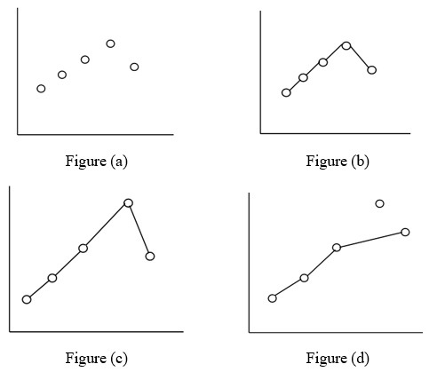
Given problem- find hypothesis ‘h’ such as h ≈ f. So,
Y= f(x) and task is to find a function h(x) that fits the point well.

Slide 8
Learning by taking advice- It is easiest and simple way of learning. In this type of learning, a programmer writes a program to give some instruction to perform a task to the computer. Once it is learned (programmed) it can do things. Also, there can be several sources for taking advice such as humans, internet etc. This type of learning has a more necessity of inference than Rote learning.
Explanation based Learning- It deals with an idea of single-example learning. Initially, an Explanation-based learning system accepts a training example. Based on given goal concept, an operationality criteria and domain theory , it generalizes the training example to describe the goal concept and to satisfy the operationality criteria (which are usually a set of rules).

Slide 9
Learning in Problem Solving- Humans tend to learn by solving various real-world problems. This is based on Reinforcement Learning. We define a utility function to check the worth of a particular outcome. In reinforcement learning, the system know the desirable outcomes but does not know which action result into desirable outcomes.

Slide 10
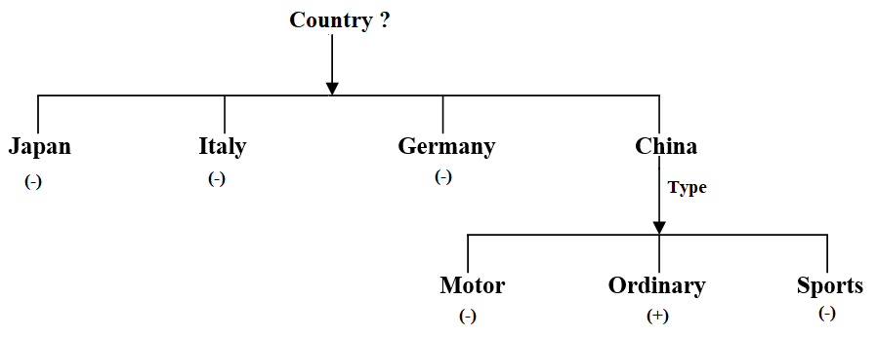
Decision Tree-
Decision tree approach of Induction learning classify the concept description at different levels of tree, giving positive and negative instances of a concept at each level. The Decision tree algorithm of ID3 program of Quinlan(1986), builds simple trees than complex ones, as it thinks that simple tree are more accurate classifiers of inputs.

Slide 11
The iterative algorithm of decision tree-
Choose random subset of training example, called window.
Build decision tree of window.
Test tree on examples outside the window
If algorithm classify correctly
HALT;
Else
Add training examples to the window and repeat step (b) to (d).

Slide 12
Support Vector Machines (SVM)-
Support Vector Machines(SVM) are powerful yet flexible supervised machine learning algorithm which are used both for classification and regression.
A SVM model is basically a representation of different classes in a hyperplane in multidimension space. The hyperplane will be generated in an iterative manner by SVM so that the error can be minimized.
The goal of SVM is to divide the datasets into classes to find Maximum Marginal Hyperplane(MMH).

Slide 13
Maximum Marginal Hyperplane(MMH):- The position of the hyper plane (a line of separation) that is furthest away from all classes of data.
Finding MMH can be done in the following steps-
First, SVM will generate hyperplanes iteratively that segregates the classes in best way.
Then, it will choose the hyperplane that separates the classes correctly.

Slide 14
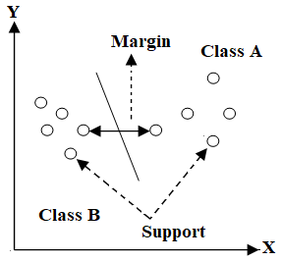

Support Vector- Data points that are closest to the hyperplane.
Hyperplane- A decision plane or space which is divided between a set of objects having different classes.
Margin- The gap between two lines on the closest data points of different classes.

Slide 15
SVM can be of two types:
Linear SVM: Linear SVM is used for linearly separable data, which means if a dataset can be classified into two classes by using a single straight line, then such data is termed as linearly separable data, and classifier is used called as Linear SVM classifier.
Non-linear SVM: Non-Linear SVM is used for non-linearly separated data, which means if a dataset cannot be classified by using a straight line, then such data is termed as non-linear data and classifier used is called as Non-linear SVM classifier.

Slide 16
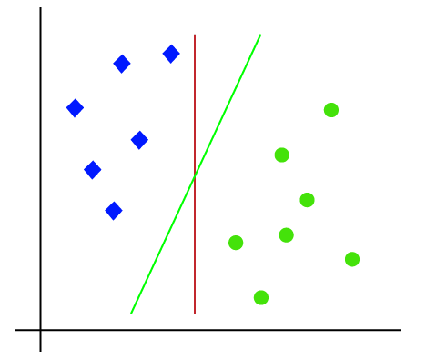
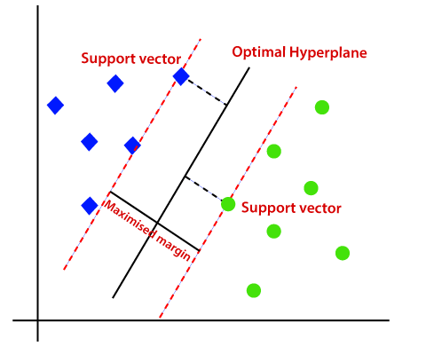
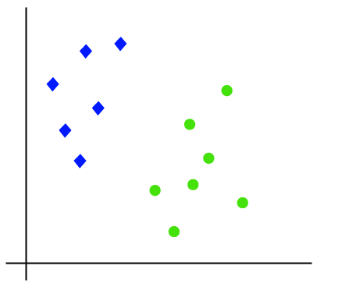
Linear Support Vector Machines

Slide 17
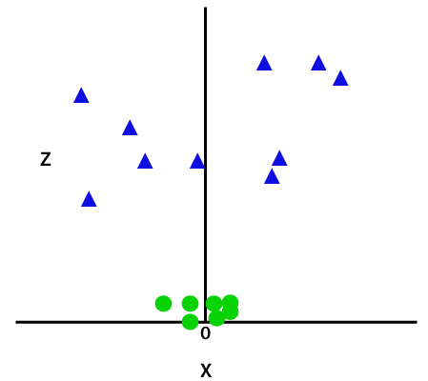
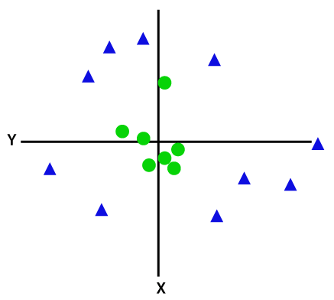
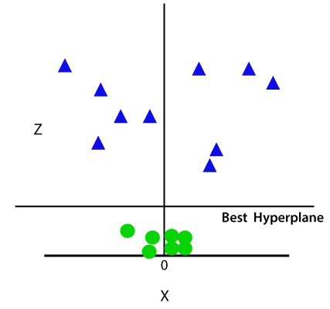
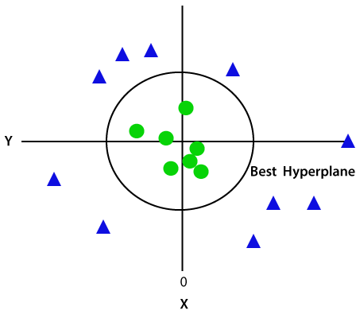
Non-linear Support Vector Machine

Slide 18
Suppose we see a strange cat that also has some features of dogs, so if we want a model that can accurately identify whether it is a cat or dog, so such a model can be created by using the SVM algorithm. We will first train our model with lots of images of cats and dogs so that it can learn about different features of cats and dogs, and then we test it with this strange creature. So as support vector creates a decision boundary between these two data (cat and dog) and choose extreme cases (support vectors), it will see the extreme case of cat and dog. Based on the support vectors, it will classify it as a cat. Consider the below diagram:

Slide 19
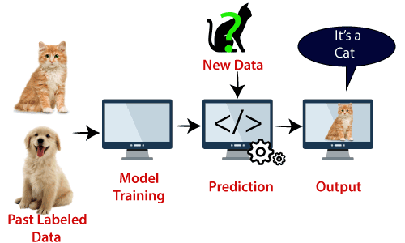

Slide 20
Advantages-
SVM classifiers offers great accuracy and work well with high dimensional space.
SVM classifiers basically use a subset of training points hence in result user very less memory.
Disadvantages-
They have high training time hence in practice not suitable for large datasets.
SVM classifiers do not work well with overlapping classes.

Slide 21
Market Basket Analysis-
Market Basket Analysis is useful unsupervised machine learning method which is used to analyze large dataset to find patterns which further represents the interesting relationship between various items.
It is mainly used to analyze customer shopping pattern. It is also termed as Association or Association Rule Mixing.
Market Basket Analysis is one of the key technique used by large retailers to uncover association between items.

Slide 22
It works by looking for combinations of items that occur together frequently in transactions. To put it another way, it allows retails to identify relationship between the items that people buy.
Association rules are widely used to analyze retail basket or transaction data and are intended to identify strong rules discovered in transaction data using measures of interestingness, based on the concept of strong rules.
Before acting on a rule, a retailer needs to know whether there is sufficient evidence to suggest that it will result in a beneficial outcome.

Slide 23
We measure the strength of a rule by calculating the following three metrics-
Support- The percentage of transactions that contain all the items in an itemset. The higher the support the more frequently the itemset occurs. Rules with a high support are preferred since they are likely to be applicable to many future transactions.
Confidence- : The probability that a transaction that contains the items on the left-hand side of the rule (Frequently bought items) also contains the item on the right-hand side(Also bought with frequently bought items) . The higher the confidence, the greater the likelihood that the item on the right-hand side will be purchased or, in other words, the greater the return rate you can expect for a given rule.

Slide 24
Lift- The probability of all the items in a rule occurring together (otherwise known as the support) divided by the product of the probabilities of the items on the left- and right-hand side occurring as if there was no association between them.
“Market Basket Analysis allows retailers to identify relationships between the products that people buy.”

Slide 25
Example- Assume there are 100 customers. 10 of them bought milk, 8 bought butter and 6 bought both.
Support = P(Milk & Butter) = 6/ 100 = 0.06
Confidence = Support/P(Butter) = 0.06/ 0.08 = 0.75
Lift = Confidence/ P(Milk) = 0.75/0.10 = 7.5

Slide 26
To perform a Market Basket Analysis and identify potential rules, a data mining algorithm called the ‘Apriori Algorithm’ is commonly used, which works in two steps:
Systematically identify item sets that occur frequently in the data set with a support greater than a pre-specified threshold.
Calculate the confidence of all possible rules given the frequent item sets and keep only those with a confidence greater than a pre-specified threshold.

Slide 27
The basic steps are-
Load Packages
Data Preprocessing and Exploring
Segregate data as per the requirement-
What time do people often purchase online?
How many items each customer buy?
Top best sellers
Analyze Result

Slide 28
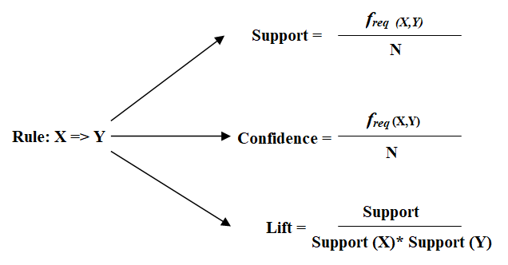

Slide 29
Artificial Neural Network-
Neural Network process information in a similar way the human brain does. The network is composed of a large number of highly interconnected processing elements working in parallel to solve a specific problem. Neural Network learn by example. They cannot be programmed to perform a specific task.
An Artificial Neural Network is configured for a specific application such as pattern reorganization or data classification etc. through learning process.

Slide 30
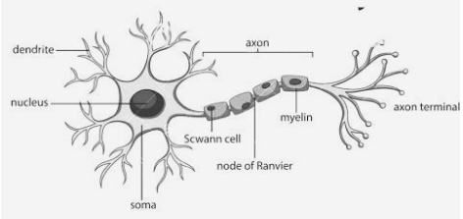

Slide 31
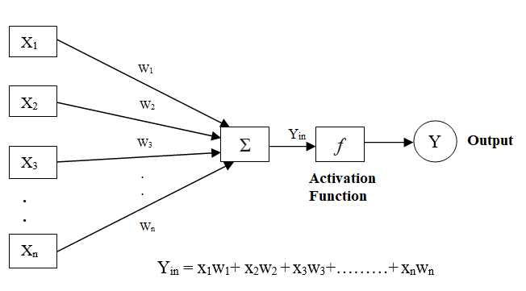
A typical neuron collects signal from others through a host of fine structures called Dendrites. The neuron sends out spikes of electrical activity though a long thin strand called Axon, which splits into thousands of branches. There is a synapses at the end of Axons which is connected to the dendrites of other neurons.

Slide 32
Processing of Artificial Neural Network depends on the following three building blocks-
Network Topologies- Network Topology is the arrangement of a network along with its nodes and connecting lives. According to this Artificial Neural Network can be classified into following kinds-
Feedforward Network- Each neuron in one layer is associated with each neuron on the following layer. The data is fed forward constantly starting with one layer then onto the next, additionally there is no connection among neurons in a similar layer.

Slide 33
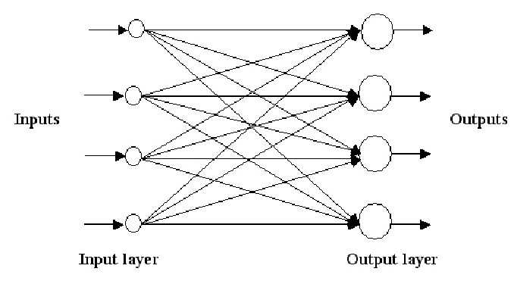
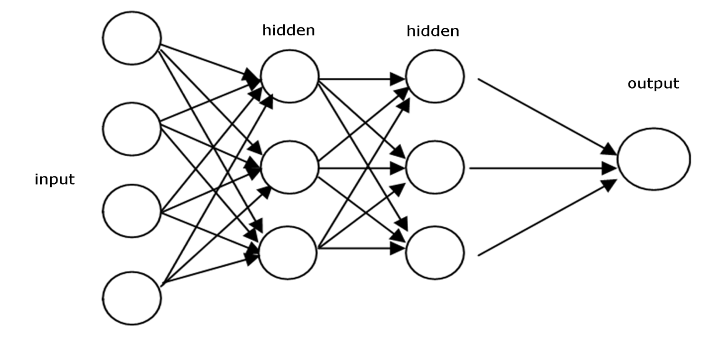
(a) Single layer Feedforward Network (b) Multilayer Feedforward Network

Slide 34
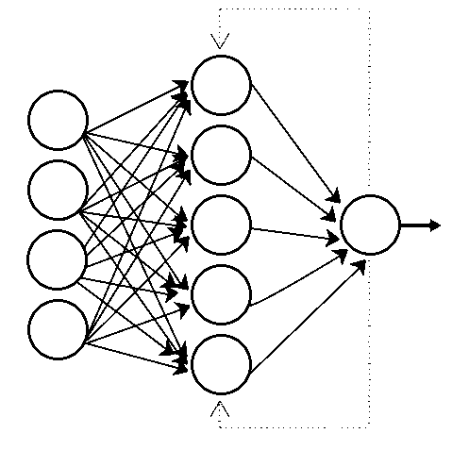
Feedback organize Neural Network: In this system, the signals are allowed to travel in both the directions by introducing loops. Such type of networks are very complicated and powerful.

Slide 35
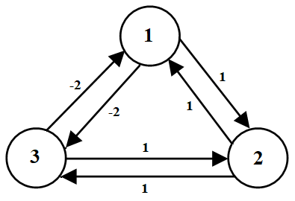
Hopfield Neural Network- This is a type of feedback neural network. In this, all the nodes are input to each other, and they are also output . The purpose of a Hopfield network is to store one or more patterns and to recall the full pattern based on partial input.

Slide 36
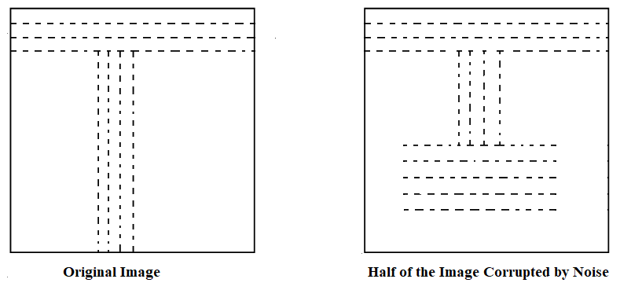
Example- Consider the problem of optimal character recognition. The task is to scan an input text and extract the character out and put them in a text file a now consider, you have spilled some coffee on the text you want to scan so there are some characters which are not visible clearly.

Slide 37
Now we will map it out so that each pixel is one node in the network. We train it to recognize each of the 26 characters, in both upper and lower case. So, when we find input as the right-hand side image (distorted image) then it will process it with few interactions and reproduces the pattern which is on left hand side image(original image).
Self organization Neural Network: In this network, an adaptive resonance theory (ART model) and Kohonen model are used as representatives and mainly utilized for cluster analysis.

Slide 38
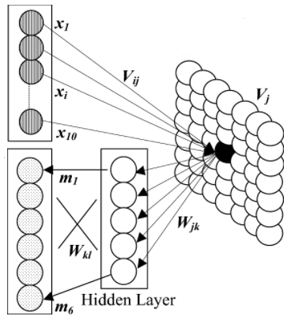

Slide 39
Adjustment of Weights or Learning- There are several learning algorithms that are used for training and these algorithms are based on various types of Machine Learning algorithms like Unsupervised Learning(Hebbian Learning Rule, WTA- Winner Takes All) Supervised Learning(Outstar learning rule, Widrow- Hoff (LMS) learning rule) etc.
Activation Function- The transfer function which is obtained as output from an artificial neuron and transfers the signals to another artificial neuron is known as activation function. The various activation functions are shown below:

Slide 40
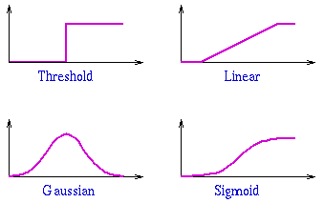

Slide 41
Neural network tools
Neural network tools help us to create ANN, train the designed ANN also test and run the designed ANNs. Some of the tools are discussed below in brief:
MATLAB Neural Network Toolbox- Complex nonlinear systems can be easily modeled with MATLAB Neural Network Toolbox. It supports various models of supervised learning techniques as well as unsupervised learning. The user can design, visualize, and simulate different neural networks with this toolbox.

Slide 42
NeuroSolutions- It is a development environment for various neural networks. It is a network design interface used to implement various advanced learning methods. It is used to train supervised learning models as well as unsupervised learning models. Various operations such as Data mining, function approximation, time-series prediction, classification, and multivariate regression can be performed by this software.
NeuroShell 2- NeuroShell 2 is used to create various neural network applications. It consists of various neural network architectures. User can manipulate data and train the network as well using this software. The trained data can be applied to new data for exporting various results to other programs. It includes both beginners’ as well as advanced systems facilities.

Slide 43
NnetLib ‘C’- The implementation of Neural Networks for C programmers is done by using the functions and data structures. Kohonen Network, backpropagation network and Hopfield network can be implemented using this. It runs on DOS, Windows (DLL).

